Slide 1
OCT correlations
Adam Shah

Slide 2
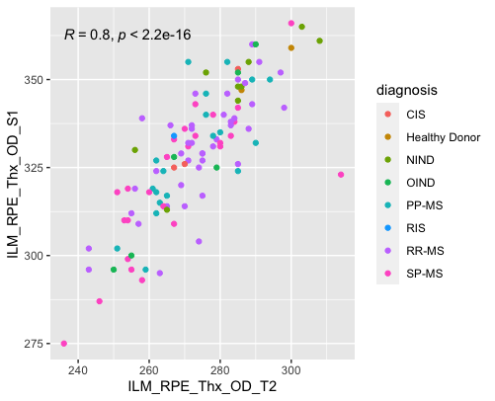
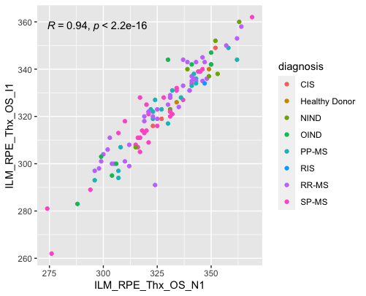
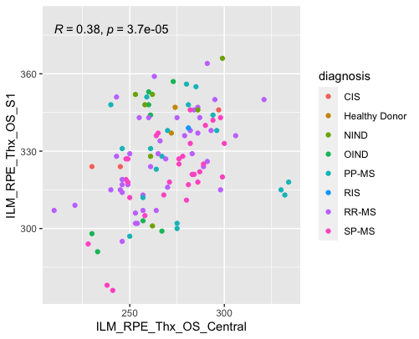
Example OCT correlations with full data set (same eye)
*greater correlation between regions the same distance from central fovea,
lesser correlation between the center and other regions

Slide 3
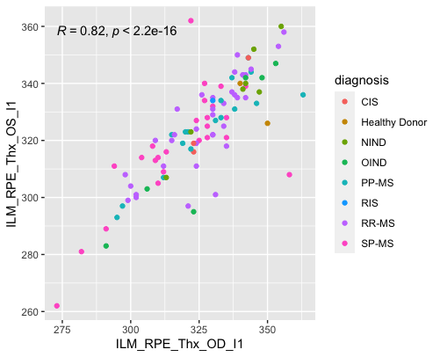
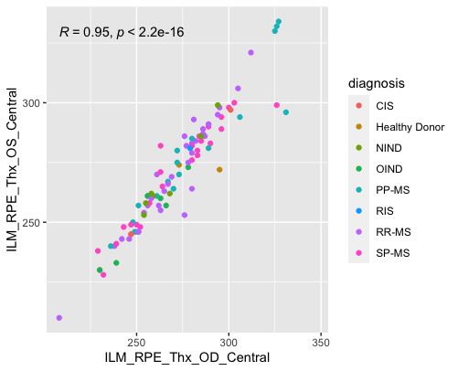
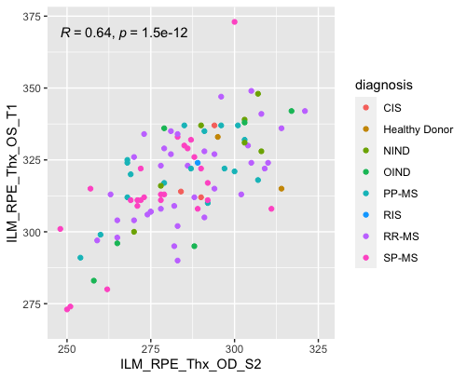
Example OCT correlations across eyes

Slide 4
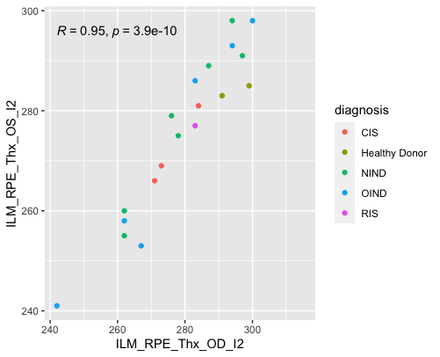
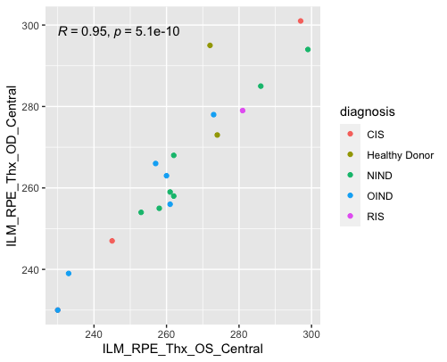
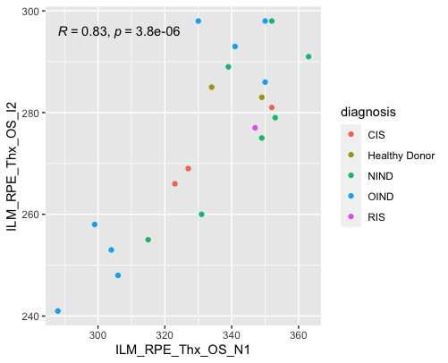
Example OCT correlations with only non-MS patients
*Correlations appear stronger in same region across eyes
than previously when including MS patients (possibly more
balance between eyes)

Slide 5
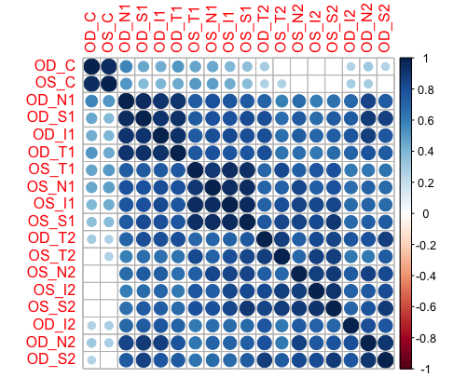
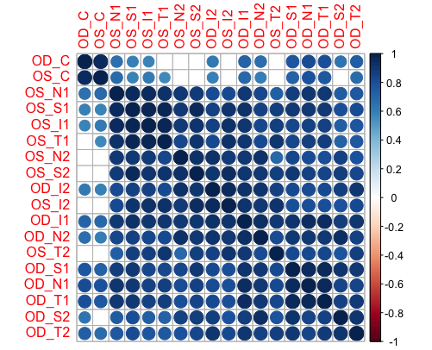
Pearson correlation plots for all OCT measurements (hierarchical clustering)
*blanks represent p-value>0.01
Full data set (n=113)
Non-MS cohort (n=21)

